Slide 1
INSTRUCTIONS
Use Font size 22 to 28 and Font Style Times New Roman (body)
Do not change the Template: Heading / Title of the slides
Do not change font style or colours
Do not copy paste paragraphs: use only Bullet Points
Maximum slide Limit is 20 only
As per the number of supervisor allotted adopt slide-2 or slide-3
Please display the required meaningful Content or images or tables
Change the footer accordingly using insert tab then click on header & footer tab and edit it
Save the PPT with Register No, Dept and Review no, example: 23xxxxxxxxx_CSE

Slide 2

Title: Interactive Movie Booking System
Student Name: CH.Goutham Teja
Student ID: 2520090225
Cluster:01
Section: 02
Under the Guidance
of
Supervisor Name: Ms.Sindhu
Assistant Professor
Department of CSE

Slide 3
OUTLINE
Abstract
Existing System
Proposed System
System Architecture
Project Modules
Objectives
Co’s Attainments - FWD
Co1
Co2 …….. 5. Co5
Co’s Attainments - DSA
Co1
Co2 …….. 5. Co5
Screen Shots for FWD & DSA
Conclusion
Geo-Tagged Photos

Slide 4
Abstract
This project focuses on developing a web-based platform that allows users to share and explore movie reviews. The website provides a simple and user-friendly interface where users can browse different movies, read reviews written by other users, and submit their own opinions and ratings. The main goal of the project is to create a centralized platform where movie enthusiasts can discuss films and help others decide what to watch.
The system is designed using web technologies such as HTML, CSS, JavaScript, and Java (for backend logic). It implements basic data structures and concepts like arrays, sorting, stacks, queues, and hashing to efficiently store, manage, and display reviews. Users can search for movies, view ratings, and see reviews sorted based on popularity or recency.
Overall, this project demonstrates the practical implementation of web development and data structure concepts to build an interactive and useful movie review website that enhances the movie-watching experience for users.

Slide 5
Existing System
Currently, people use online platforms to read and share movie reviews before deciding what to watch. Popular websites such as IMDb, Rotten Tomatoes, and Letterboxd provide movie ratings, reviews, and detailed information about films. These platforms allow users to browse movies, read reviews from critics and audiences, and sometimes post their own reviews.
However, many of these systems are large and complex, containing many additional features that may not be necessary for basic review sharing. Some platforms also require account creation to access certain features, and the interface can sometimes be difficult for new users to navigate. Therefore, there is a need for a simpler system where users can easily view and submit movie reviews in a straightforward and organized manner.

Slide 6
Proposed System
The proposed system is a web-based movie review website where users can view movie ratings, read reviews from other users, and post their own reviews. The platform provides a simple and user-friendly interface for searching movies and sharing opinions. It uses data structure concepts like arrays, sorting, stacks, queues, and hashing to store and manage reviews efficiently. The system aims to make movie review sharing easy and organized for users.

Slide 7
System Architecture
The system architecture of the movie review website follows a simple three-layer structure: presentation layer, application layer, and data layer. The presentation layer is the user interface built using HTML, CSS, and JavaScript, where users can view movies, read reviews, and submit their own reviews. The application layer processes user requests and handles the logic using Java, including operations like storing reviews, sorting ratings, and managing user data. The data layer stores the movie details and user reviews, which are organized using data structure concepts such as arrays, stacks, queues, and hashing. All these components work together to provide a smooth and efficient movie review platform.

Slide 8
Project Modules
User Module – Allows users to register/login, view movies, read reviews, and submit their own reviews and ratings.
Movie Module – Manages the list of movies available on the website and displays movie details.
Review Module – Enables users to write reviews, give ratings, and view reviews posted by other users.
Search and Sorting Module – Helps users search for movies and view reviews sorted by rating or latest posts using data structure concepts.
Data Management Module – Stores and manages movie information and user reviews efficiently using arrays, hashing, stacks, and queues.

Slide 9
Objectives
To develop a user-friendly website for sharing and viewing movie reviews.
To allow users to post their own reviews and ratings for movies.
To enable users to read and explore reviews written by other users.
To organize and manage movie review data efficiently using data structure concepts.
To provide an easy platform for movie lovers to discover and discuss movies. 🎬

Slide 10
Co’s Attainments - FWD
CO1 - Apply Internet Fundamentals, HTML & Introductory CSS Styling. CO2 - Apply HTML Forms, Semantic Tags & Comprehensive CSS Layouts. CO3 - Apply JavaScript Programming Essentials .CO4 - Apply JavaScript Interactivity, DOM .CO5 - Apply Advanced Web Development & Deployment.

Slide 11
Co’s Attainments - DSA
CO1 - Application of searching algorithms CO2 - Design and implement Abstract Data Types CO3 - Apply stacks and queues CO5 - Design, Develop and evaluate common practical applications for linear Data Structures dsa

Slide 12
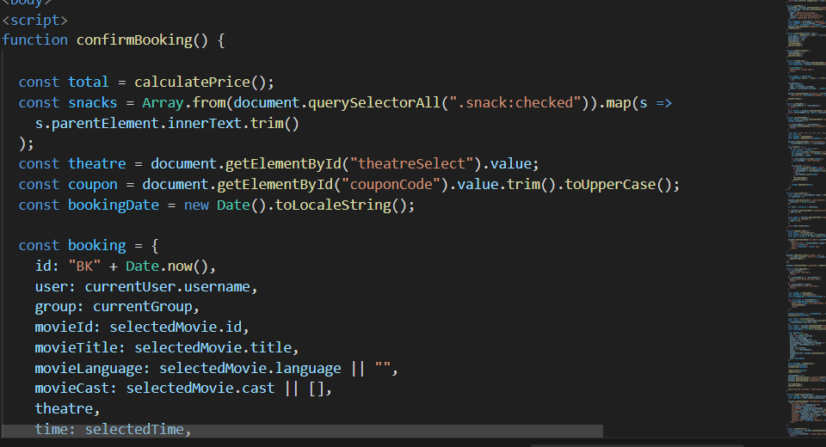
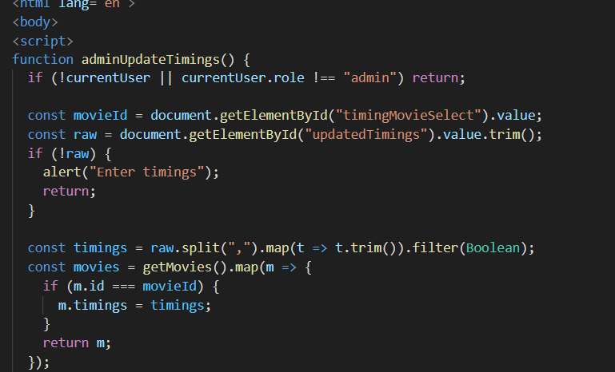
Screenshots for FWD & DSA

Slide 13
Conclusion
This project demonstrates the implementation of various Data Structures and Algorithms (DSA) concepts in a movie rating system called Cine Rate Hub. Arrays are used to store movie names and their ratings, while HashMap efficiently maps each movie to its rating. The program applies Bubble Sort to arrange movies based on ratings. A Stack is used to manage recently viewed movies following the LIFO (Last In First Out) principle, and a Queue is used to maintain a watchlist using the FIFO (First In First Out) principle. Overall, this project shows how different data structures can be used together in Java to organize, store, and process data efficiently in a simple real-world application.

Slide 14
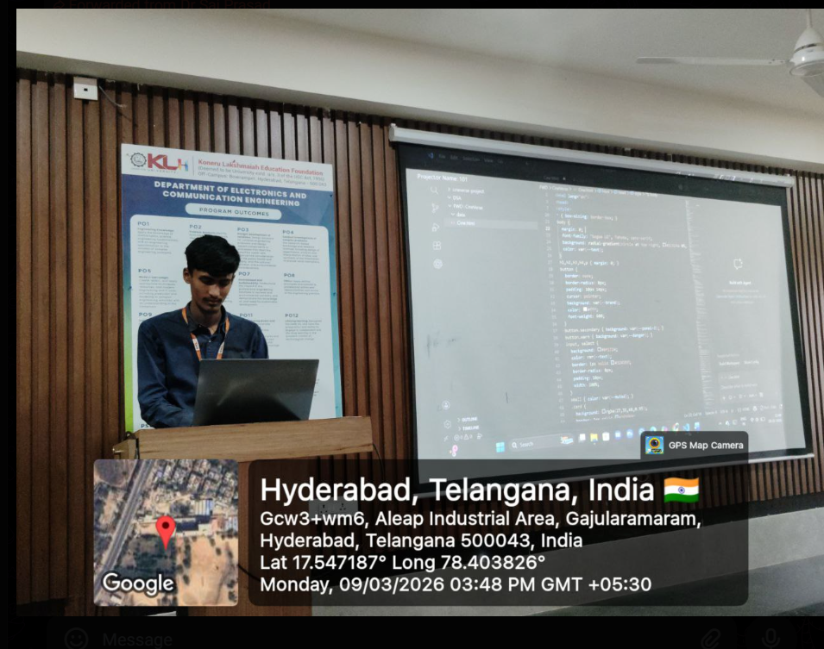
Geo- Tag Photos

Slide 15
THANK YOU

